Slide 1
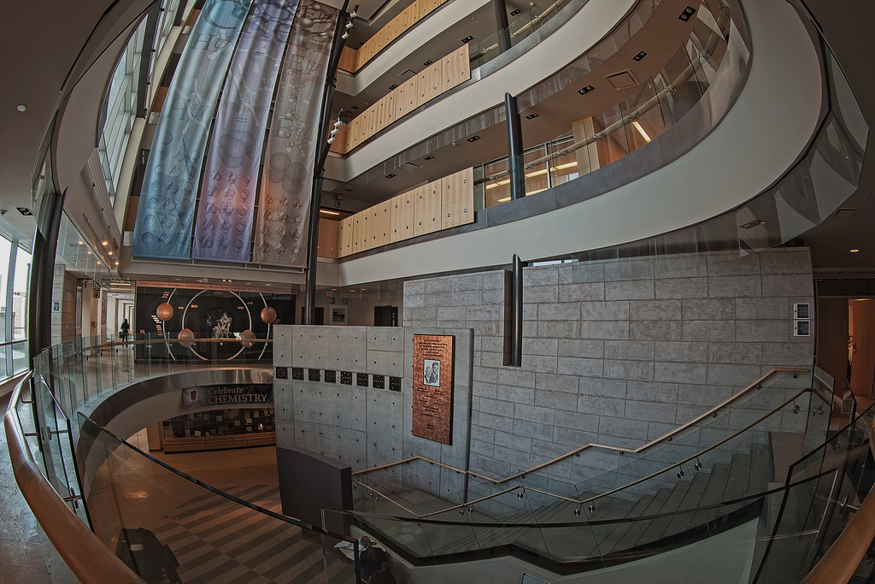
Queens’ Chemistry DSC

Slide 2
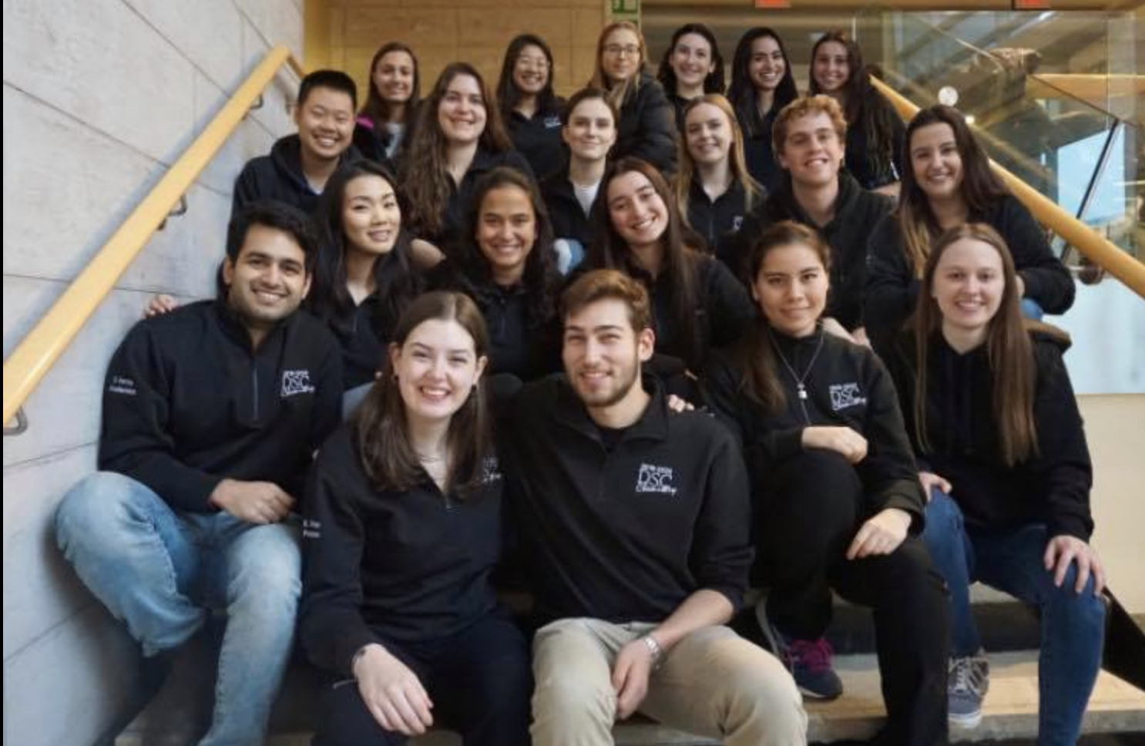
Who Are We?
Departmental
Student
Council
Events Representatives
Socials/Events Coordinators
Academics Coordinators
Fundraising Coordinators
Grad/Industry Outreach
Year Representatives
1st Year Representatives
2nd Year Representatives
3rd Year Representatives
4th Year Representatives
Operations
Presidents
Marketing Coordinators
Secretary
Treasurer

Slide 3
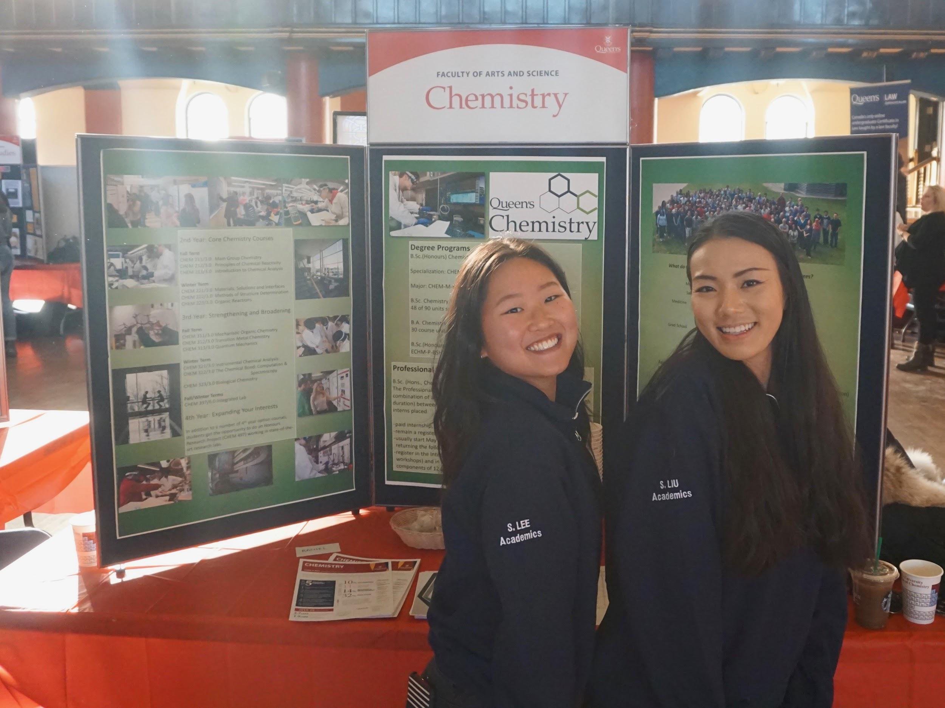
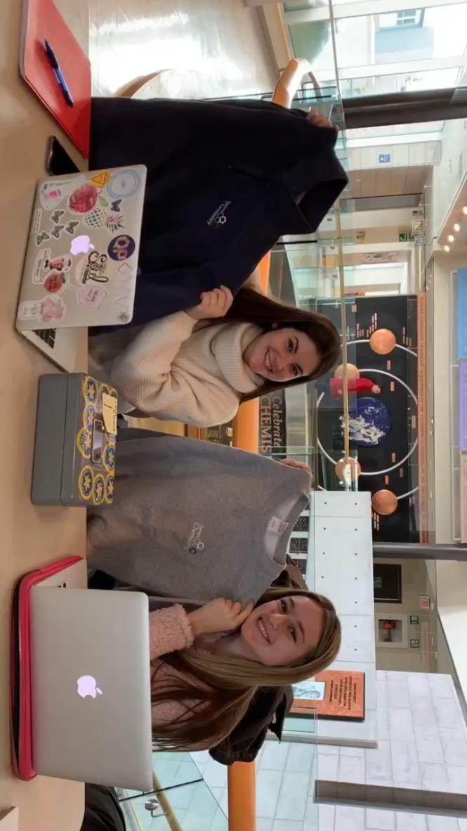
What do we do?
Clothing sales & Fundraisers
Department & ArtSci Events
Open House
Major’s Night

Slide 4
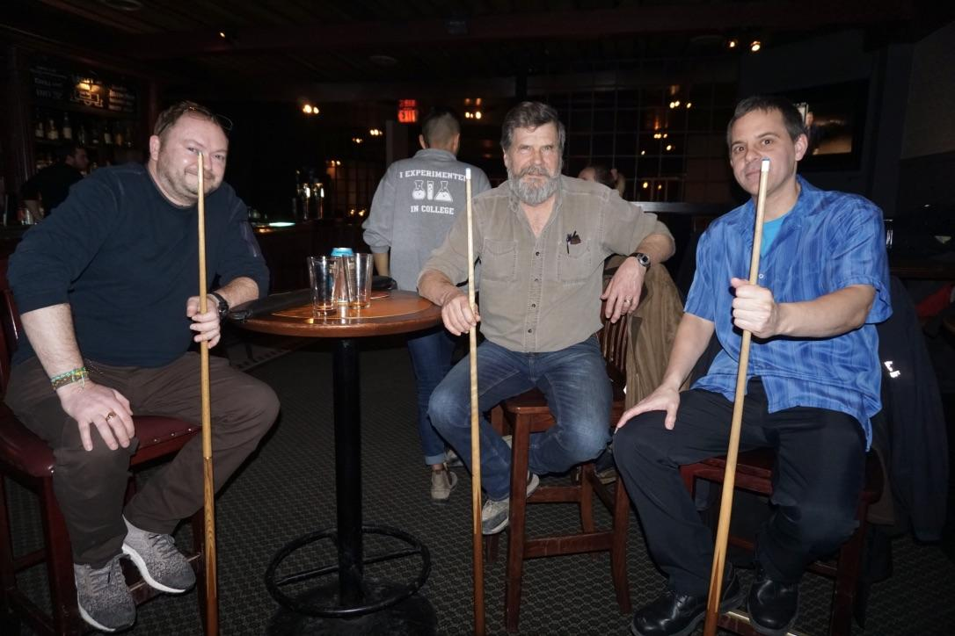
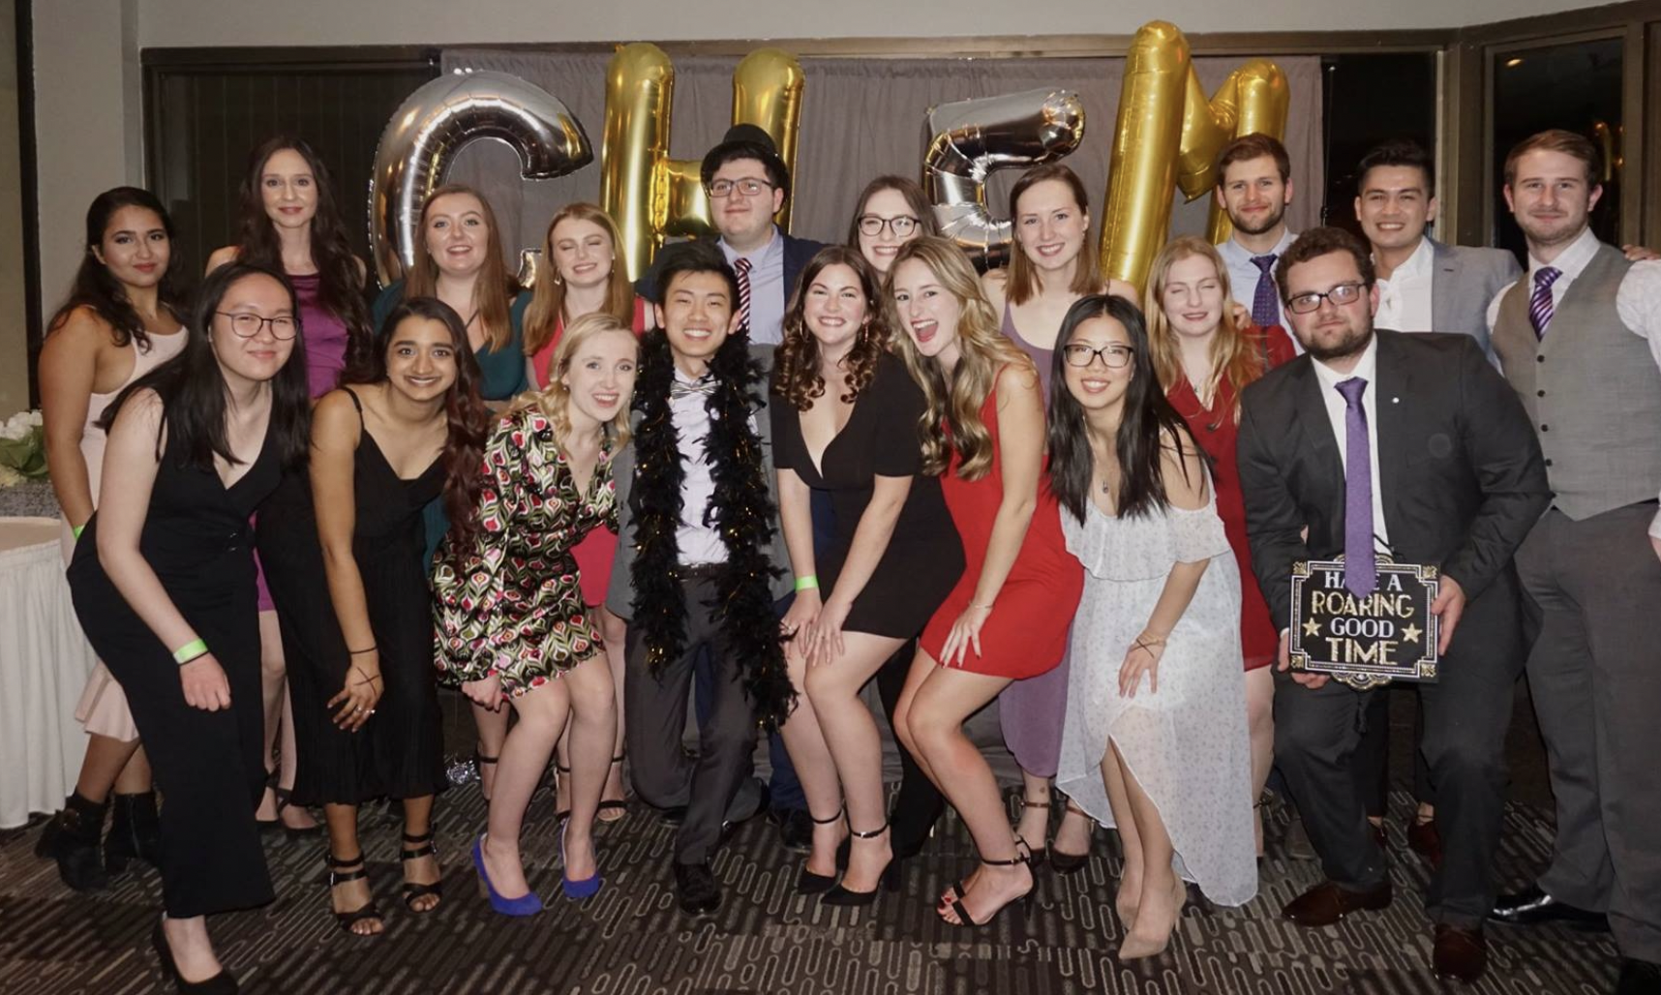
What do we do?
Social Events
Formal
Pool with Profs
Study Sessions
Academic Information Nights
Lab Writing Tips
Thesis Night

