Slide 1
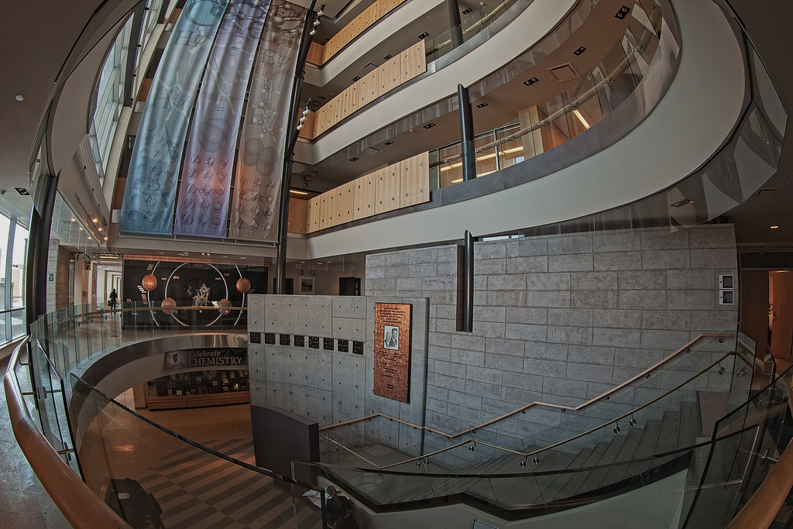
QUEEN’S
CHEMISTRY
DSC

Slide 2
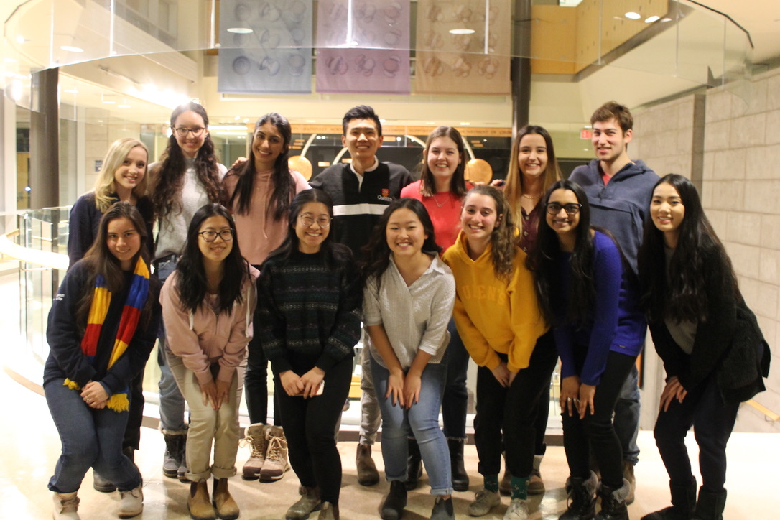
WHO ARE WE?
Departmental
Student
Council
This Years Positions:
President, Secretary, Event Coordinators, Academic Coordinators, Social Media, Treasurer, Year Reps

Slide 3
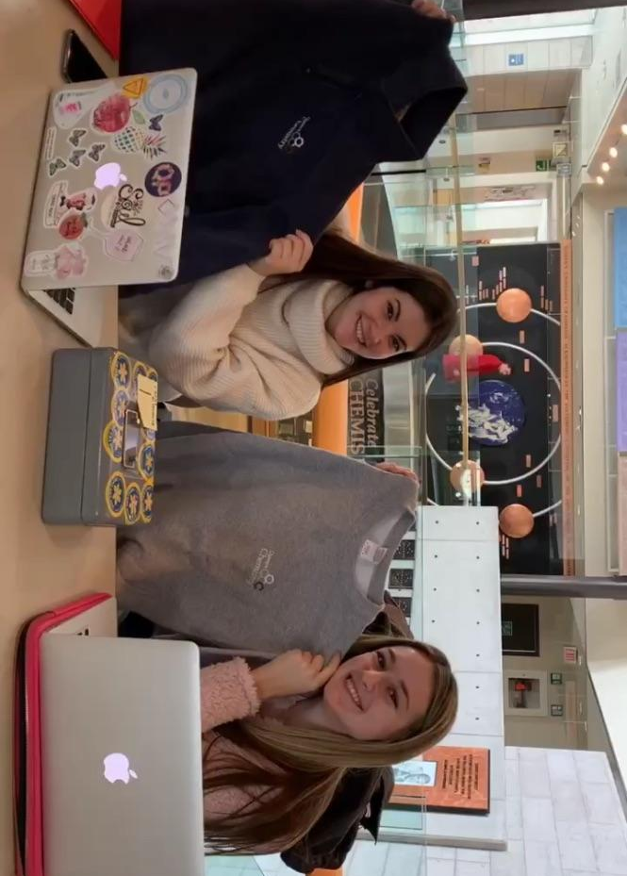
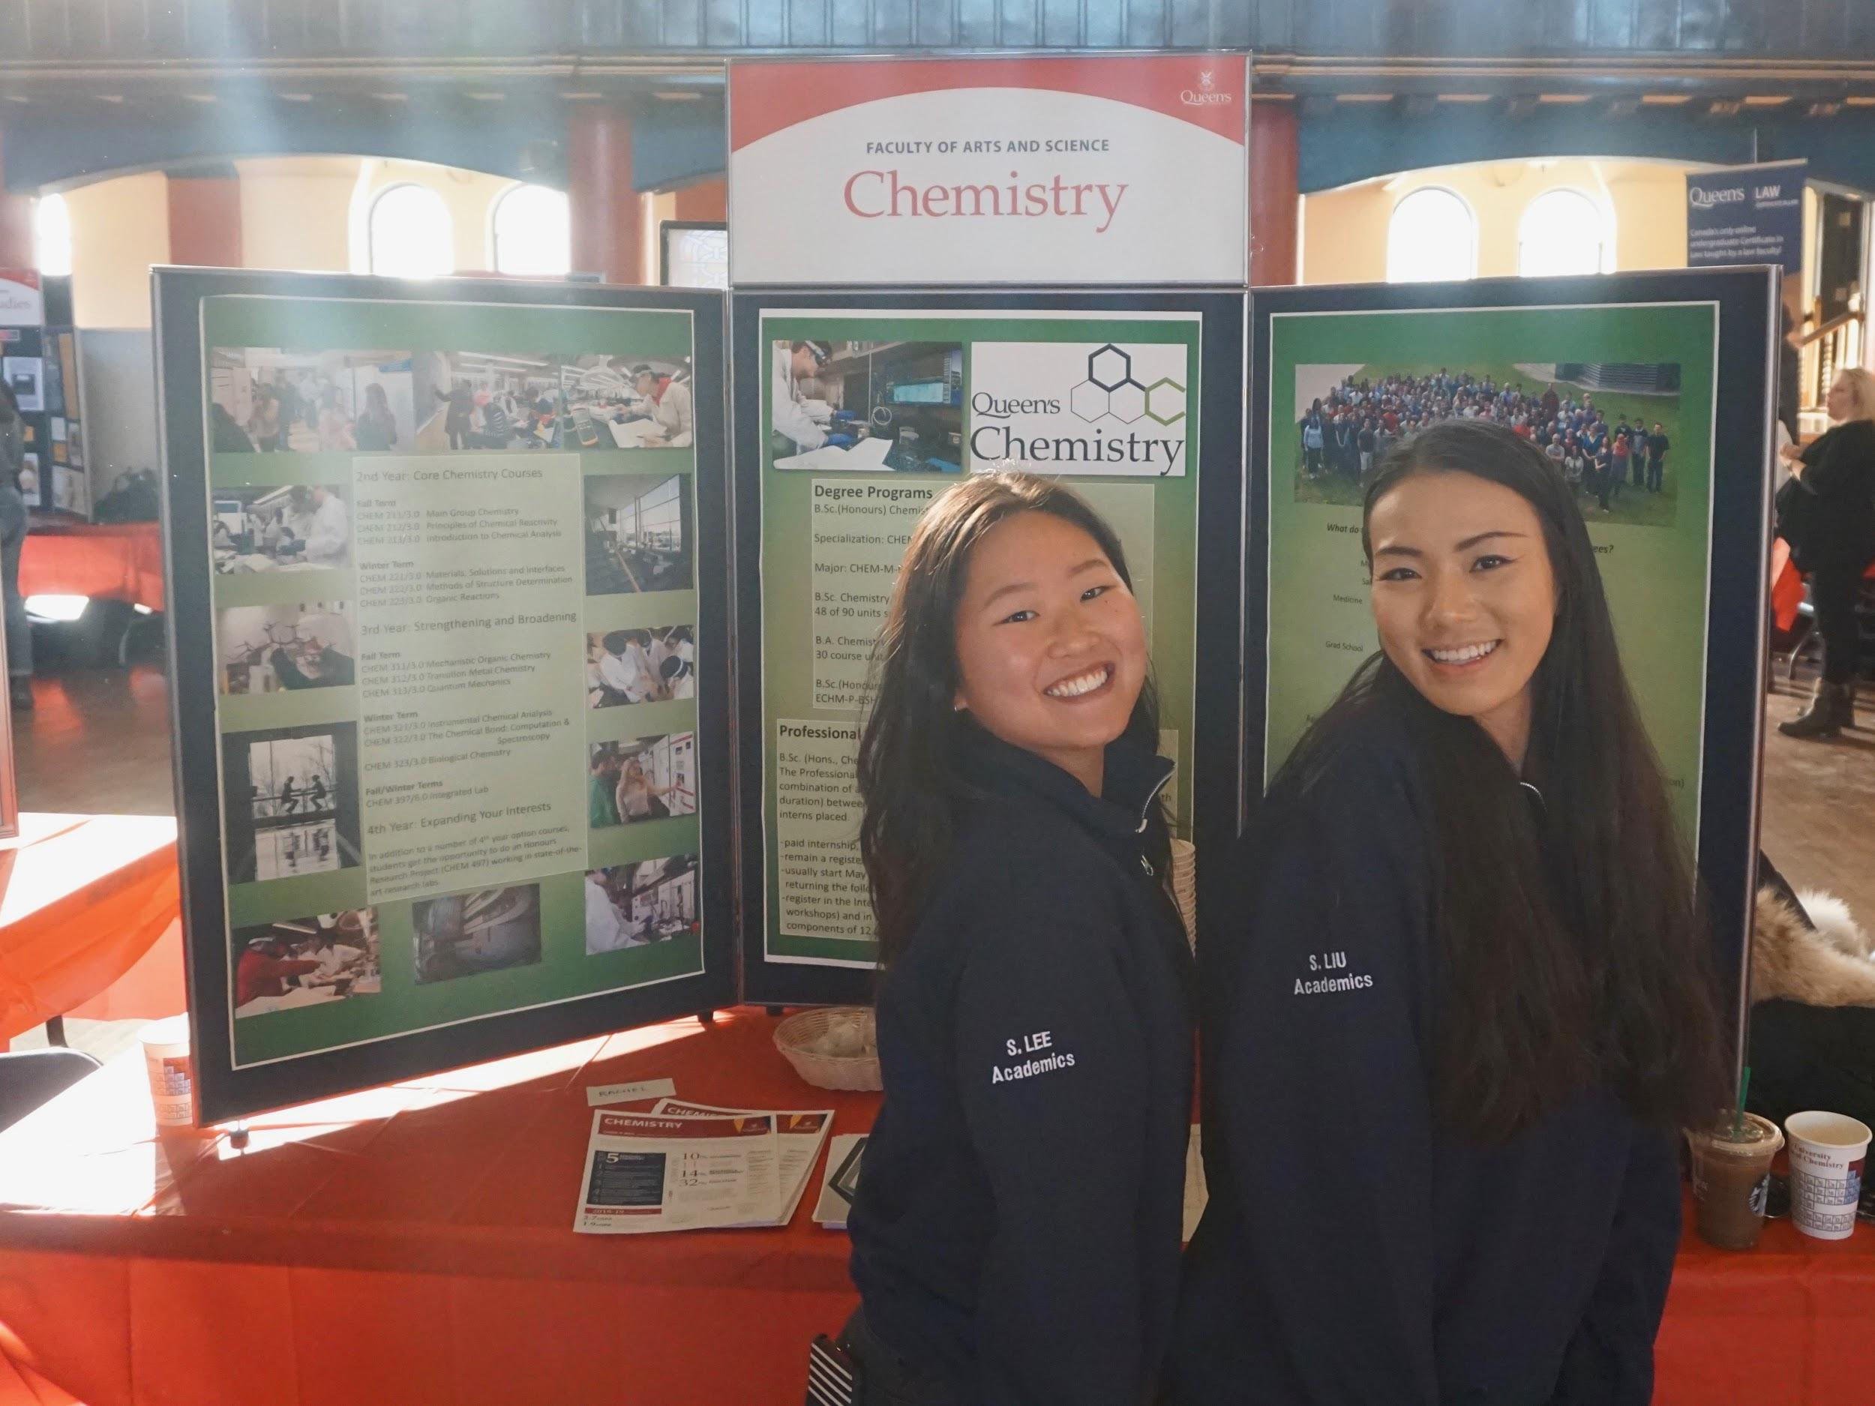
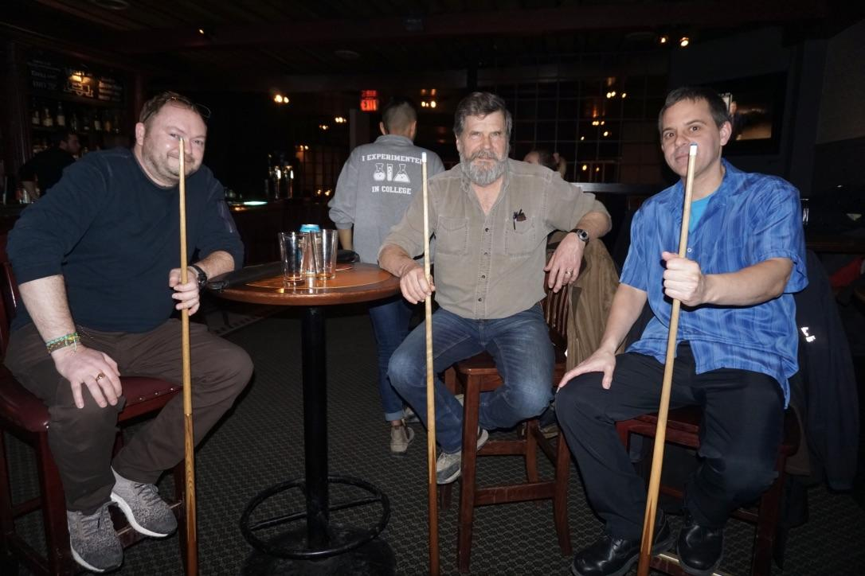
WHAT DO WE DO? (USUALLY)
Distribute USATs
Clothing Sale & other fundraisers
Help out with department events and ArtSci events
Major’s Night
1st Year Information Night
Plan and host our own events
Group Study Sessions
Pool with Profs
Chem Formal!!!

Slide 4
Meet...
Josh Kofsky (3rd Year, Chemistry, Specialization)
&
Alicia Gowan (4th Year, Environmental Chemistry)
&
Jansen Lau (4th Year, Chemistry/Con-Ed)
&
Subin Lee (3rd Year, Chemistry)

